Slide 1


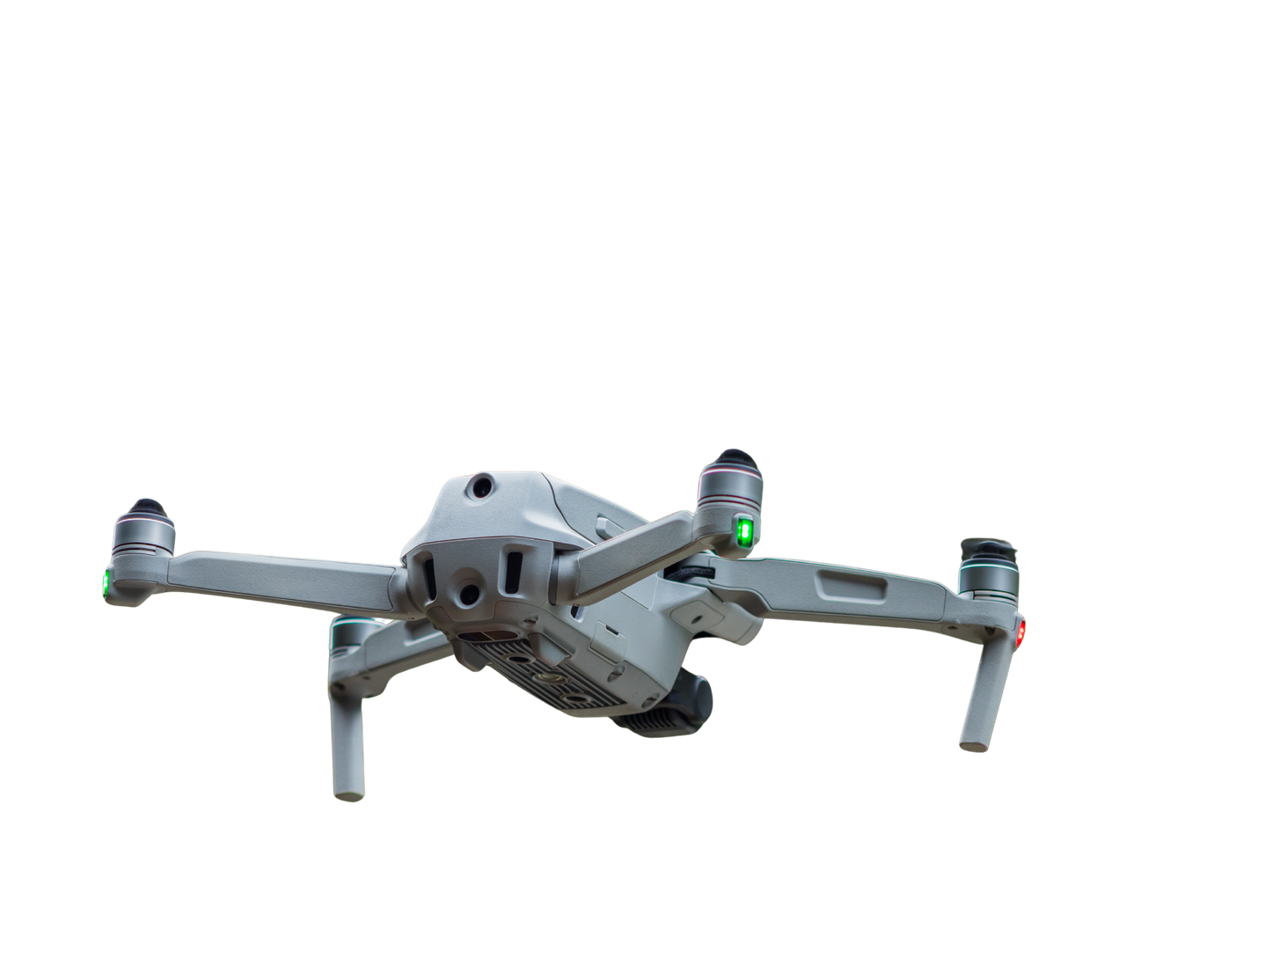
Coordinated Multi-UAV Exploration and Target Localization
An AI Framework for Autonomous Mapping of Unknown Environments
Adarsh
M.Sai Amirthesh

Slide 2

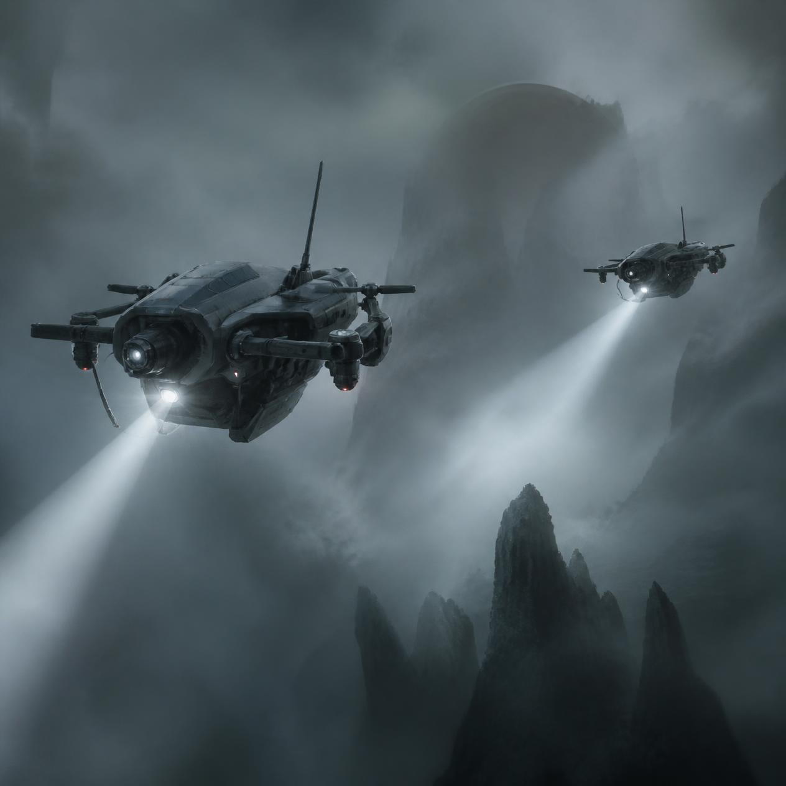

Problem & Proposed Idea
Problem
When multiple UAVs explore an unknown environment:
  UAVs may search the same region.
  Exploration can become inefficient.
  Detected objects need to be localized on the map.
  Coordination becomes difficult as the number of UAVs increases.
.
Our Idea
Coordinate multiple UAVs to explore an unknown environment while detecting and localizing targets

Slide 3
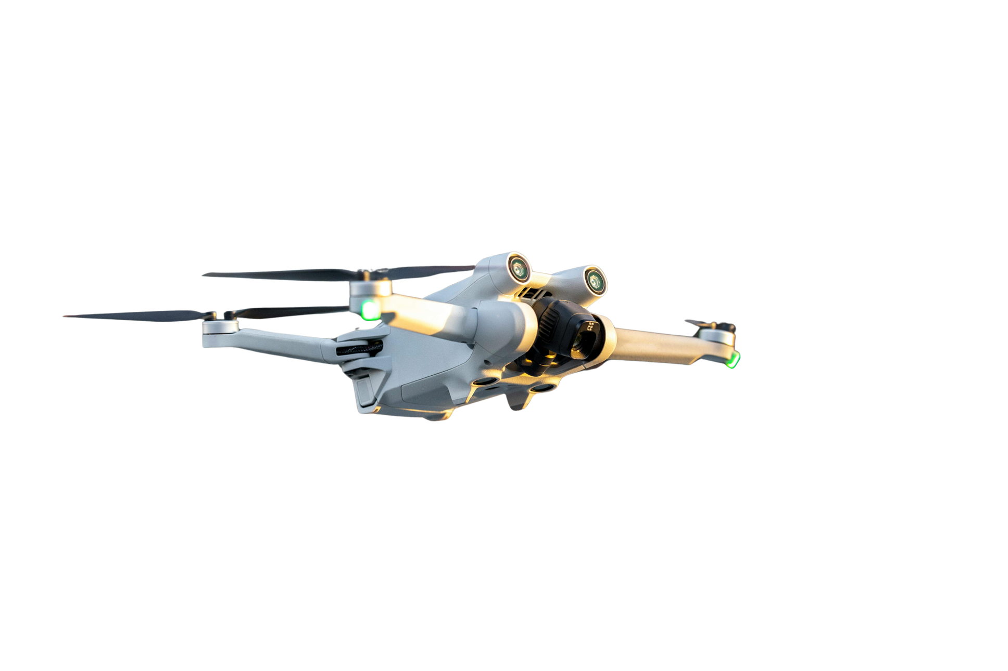
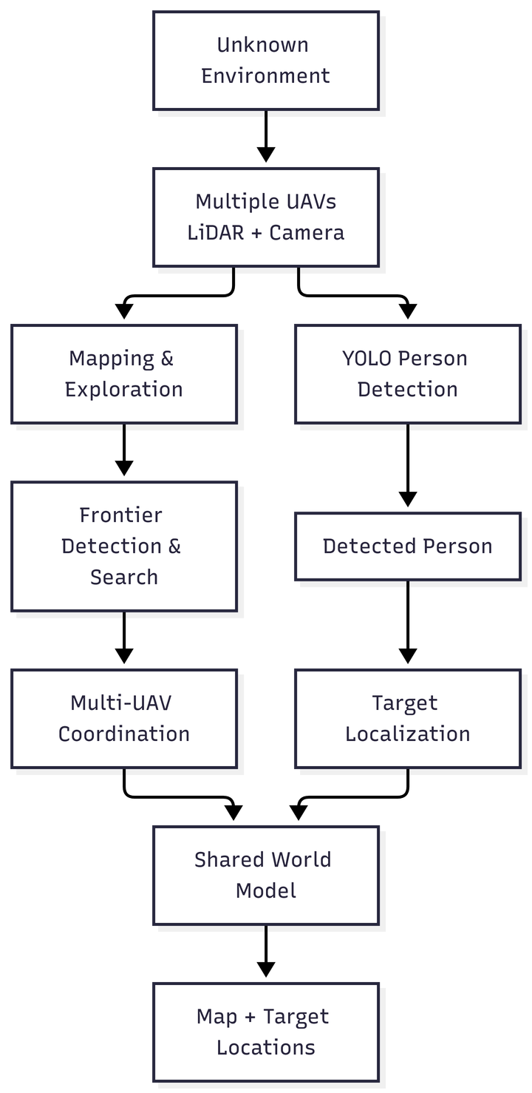
System Architecture
Simple Architecture Description
  Unknown Environment → Area that the UAVs need to explore.
  Multiple UAVs → Drones use LiDAR and cameras.
  Mapping & Exploration → UAVs explore the area and create a map.
  Frontier Search → Finds unexplored areas.
  Multi-UAV Coordination → Divides the search between UAVs.
  YOLO Detection → Detects people using the camera.
  Target Localization → Finds the person's location on the map.
  Shared World Model → Combines the map and detected targets.
  Final Output → Map with the detected person's location.

Slide 4

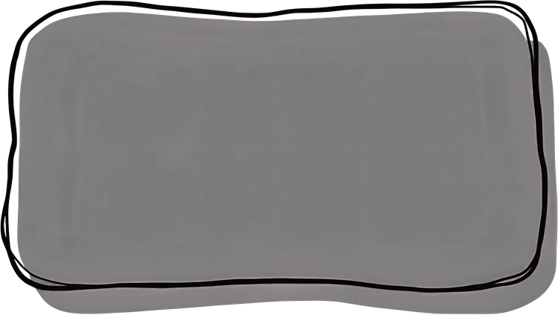
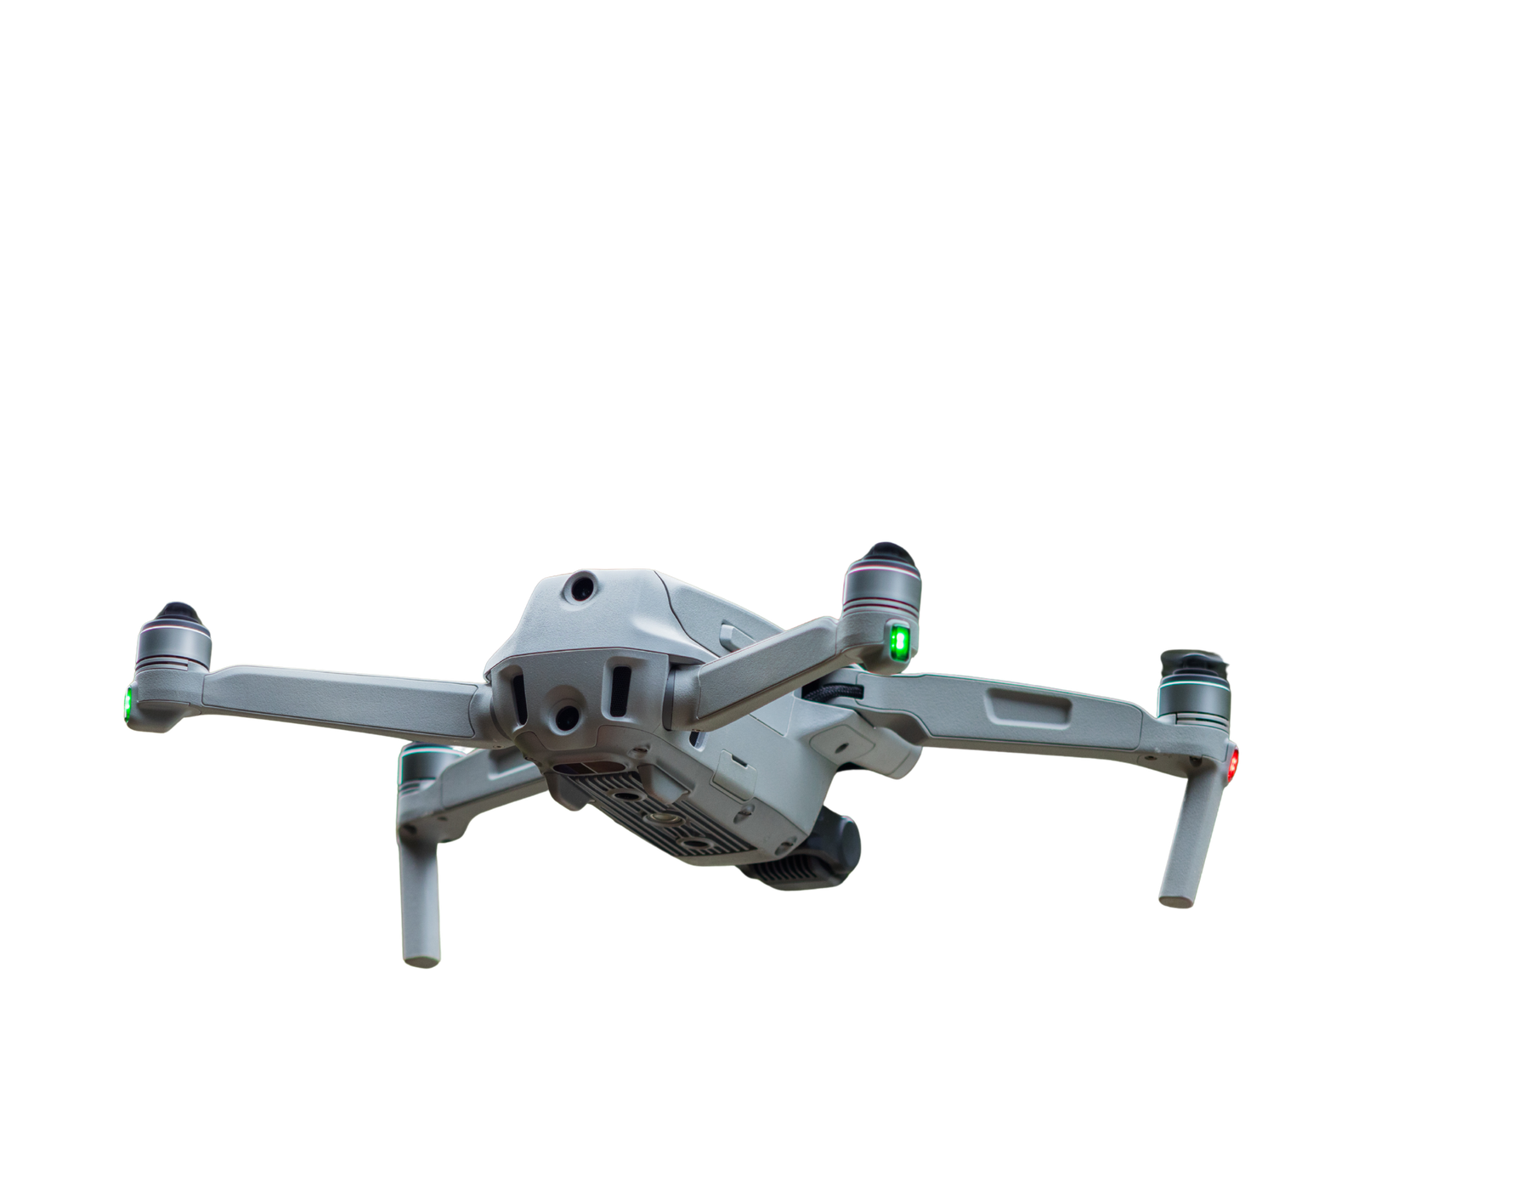
System Modules
  2D/3D simulated environment
  LiDAR sensing
  Occupancy representation
Environment & Mapping
  Frontier detection
  Search/path planning
  Multi-UAV coordination
Multi-UAV Exploration
  Camera input
  YOLO
  Person detection
AI-Based Detection

Slide 5

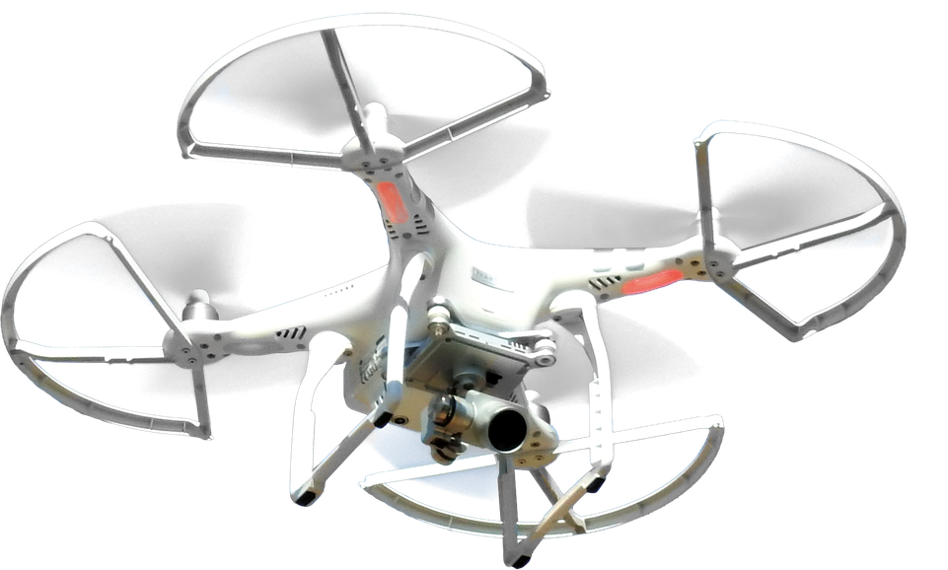
Dataset Used
Dataset Source: VisDrone2019-DET
Dataset Used
  Dataset: VisDrone2019-DET
  Images: 548
  Classes: Person + Vehicle
  Annotations: 30,212 objects
  Image Type: RGB aerial images
  Train: 438 images (80%)
  Validation: 110 images (20%)
  Test: 110 held-out images
Preprocessing
  Images resized to 800 × 800
  Original annotations converted to YOLO format
  Unwanted/ignored annotations removed
  Bounding-box coordinates normalized

Slide 6

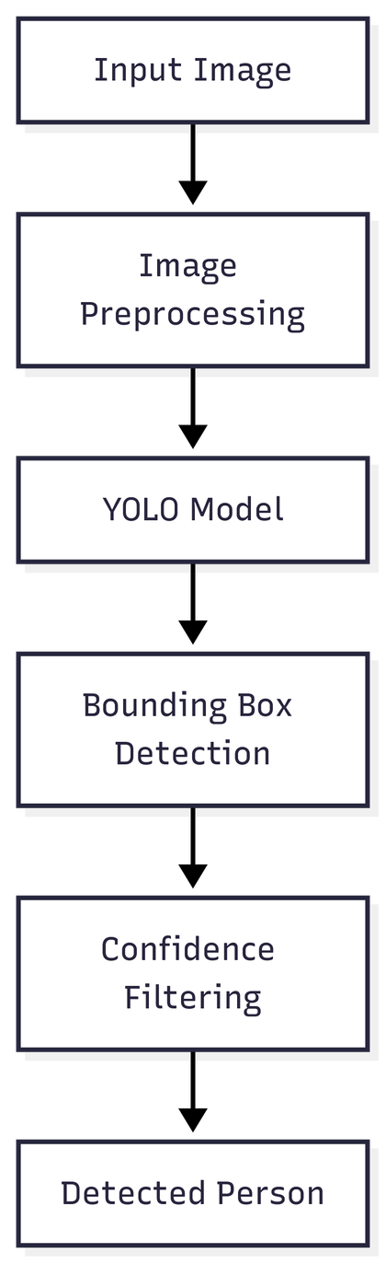

YOLO Model Implementation
  Input Image → Image captured by the UAV camera.
  Image Preprocessing → Image is prepared for the YOLO model.
  YOLO Model → Processes the image to detect objects.
  Bounding Box Detection → Identifies the location of each person.
  Confidence Filtering → Removes low-confidence detections.
  Detected Person → Final detected person is displayed.

Slide 7
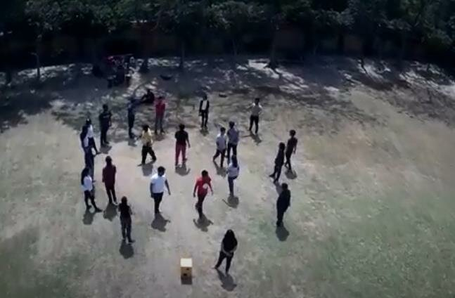
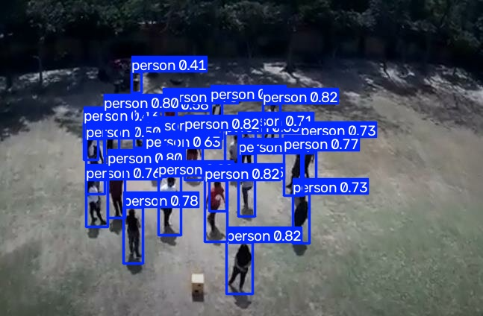

Testing
Input
Output

Slide 8
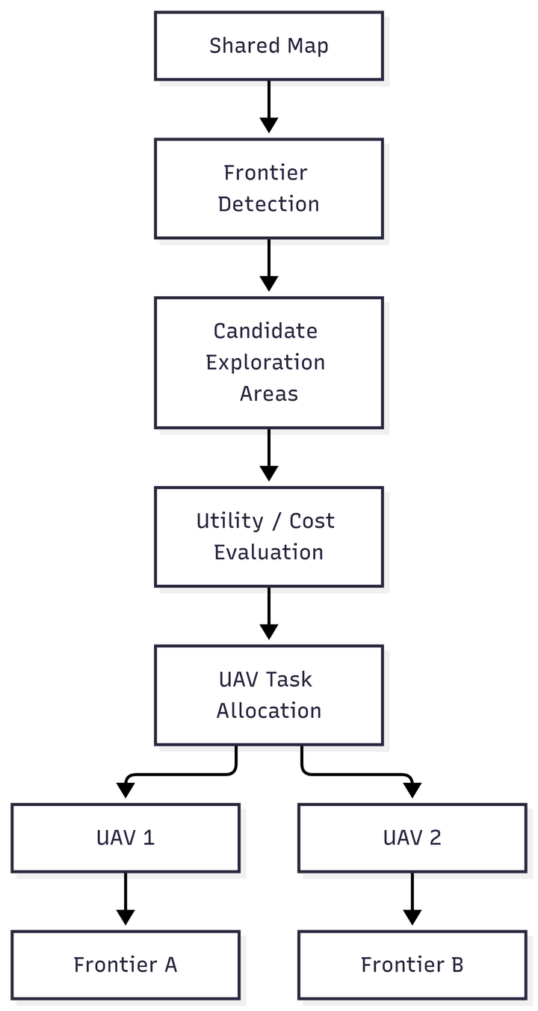
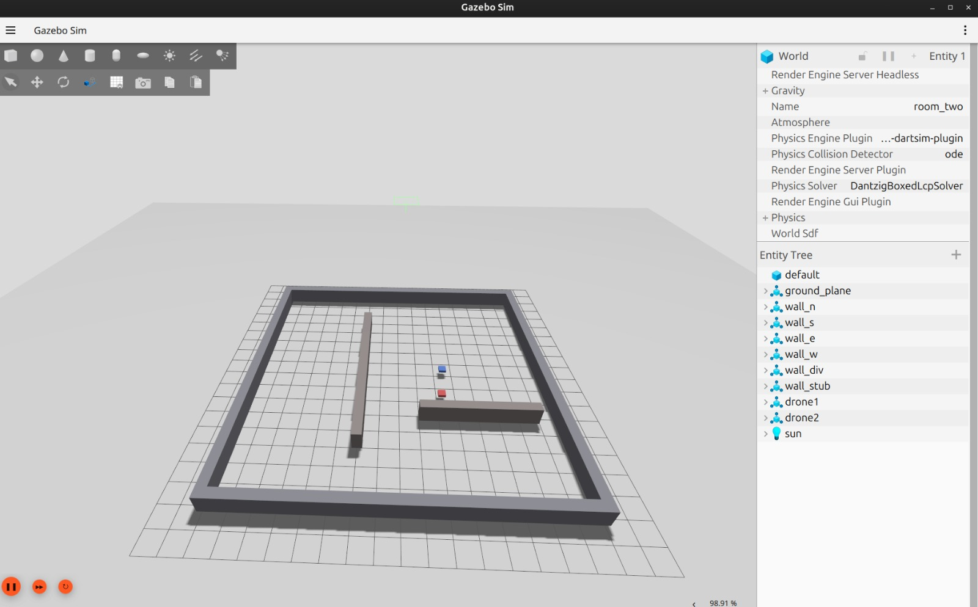
Multi-UAV Search Algorithm
Objective
Allow multiple UAVs to explore different parts of an unknown environment instead of unnecessarily searching the same region.

Slide 9

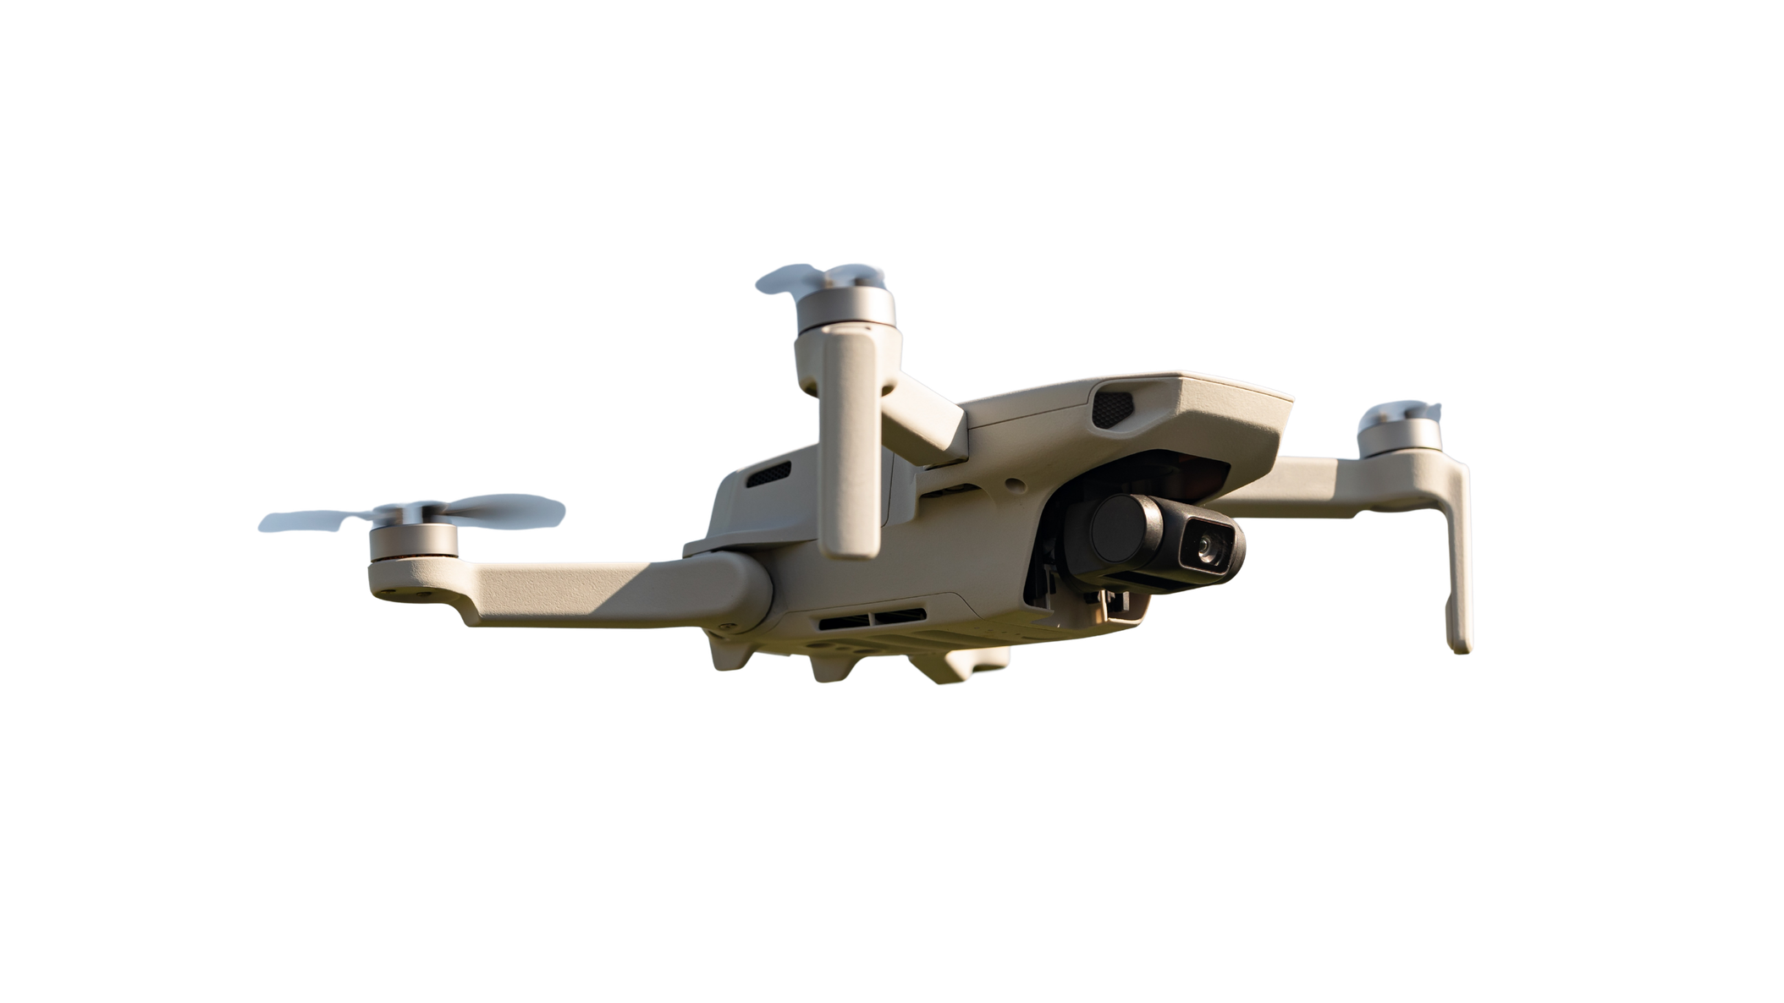
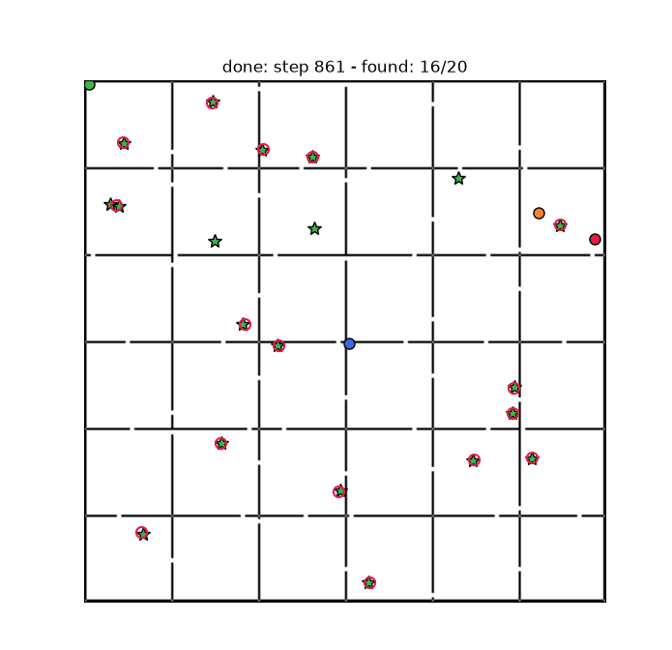
2D Search Simulation Results
Observed Results
  Multiple UAVs explore simultaneously.
  UAVs receive different exploration targets.
  Shared map is updated during exploration.
  Redundant exploration is reduced.

Slide 10
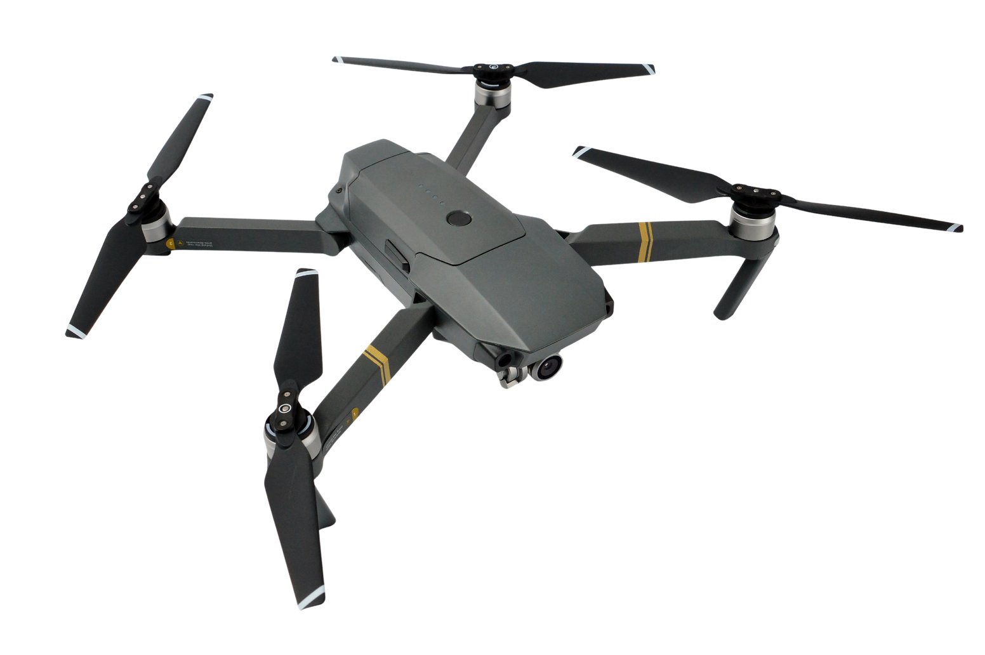
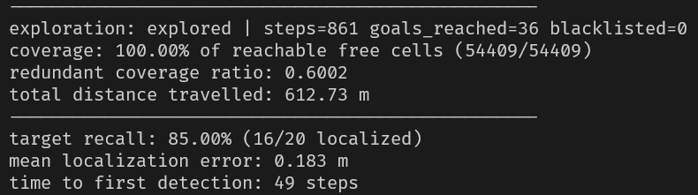
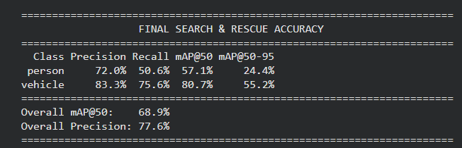
Evaluation Metrics
Multi-UAV Exploration
  Coverage: 100% in most maps; 98.4% in complex mazes
  Exploration Time: 20–25% faster with Hungarian coordination
  Path Length: 172.7 m average
  Redundant Coverage: >50% reduction
  A* Efficiency: 8.1× fewer nodes than UCS
YOLOv8 Detection
  Precision: 77.6% overall | 72.0% Person
  Recall: 63.1% overall | 50.6% Person
  mAP@50: 68.9% overall | 57.1% Person
  IoU Threshold: ≥ 0.50
Key Result
Coordinated UAVs → faster exploration + less overlap
YOLOv8 → aerial person/vehicle detection

